Slide 1
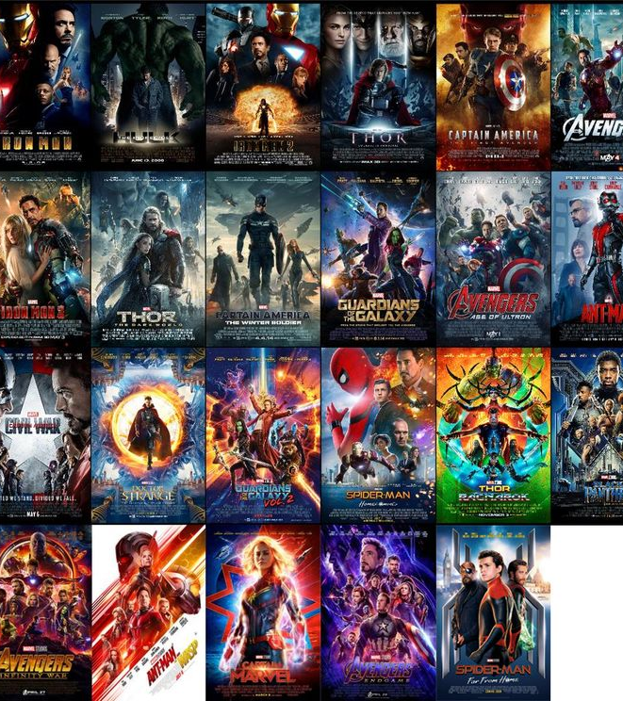

IMDB MOVIE ANALYSIS BY: AFZAL ALAM

Slide 2

INDEX
PROJECT DESCRIPTION
DATA SETS
APPROACH
TECH STACK USED
DATA ANALYSIS TASKS

Slide 3

Project Description:
The IMDb Movie Analysis project aims to explore and analyze a comprehensive dataset of movies available on the IMDb platform.
This dataset contains essential information about movies, including director names, movie titles, duration, genre, budget, gross earnings, IMDb ratings, and more.
Through in-depth data analysis using Excel, Data Visualization and Statistics techniques this project seeks to extract valuable insights and trends that contribute to a movie's success.

Slide 4

DataSets
The Cleaned Dataset
THE SOLUTION DATASET

Slide 5



Approach:
I have gone through the dataset and understood all the given columns. Then I have observed that there are a total of 28 Columns and 5043 Rows. This dataset consists of unwanted columns, Null values and Blank rows. So, I have decided to Clean this dataset thoroughly.
First, I have deleted the columns which have no relation to our project and don't provide any valuable insights. In the end, I only left with 9 Columns which are director’s name, duration, movie title, genre, budget, gross, IMDB rating, language and country.
Then, I noticed that there were many blank rows. To find them I first clicked on “Find & Select” then clicked on “go to special” and selected the “blank” option. It highlighted all the blank rows. Then I clicked the shortcut “CTRL + - ” and selected the “Entire rows” option. This process deleted the entire blank rows in the dataset.
Finally, I also deleted the duplicate rows present in the dataset. Now, I left with a total of 9 Columns and 3786 Rows.

Slide 6

TECH USED
For this project, I utilized Excel software along with charts, and macros. Excel's pivot tables allowed me to efficiently analyze and summarize the IMDB data, while the charts helped in visually representing the information. The combination of these tools in Excel proved to be instrumental in conducting data analysis and presenting the findings effectively.

Slide 7

DATA ANALYTICS TASK:
Movie genre analysis
Movie duration Analysis
Language analysis
Director analysis
Budget analysis

Slide 8
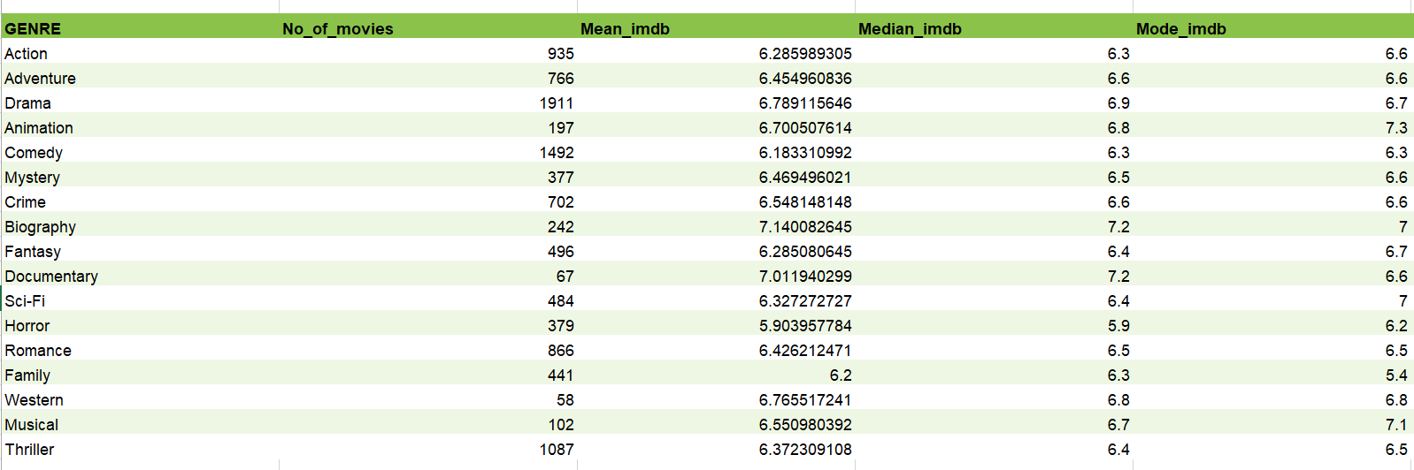
A: Movie Genre Analysis:
Analyze the distribution of movie genres and their impact on the IMDB score.
Task: Determine the most common genres of movies in the dataset. Then,
for each genre, calculate descriptive statistics (mean, median, mode, range,
variance, standard deviation) of the IMDB scores.
Results:

Slide 9
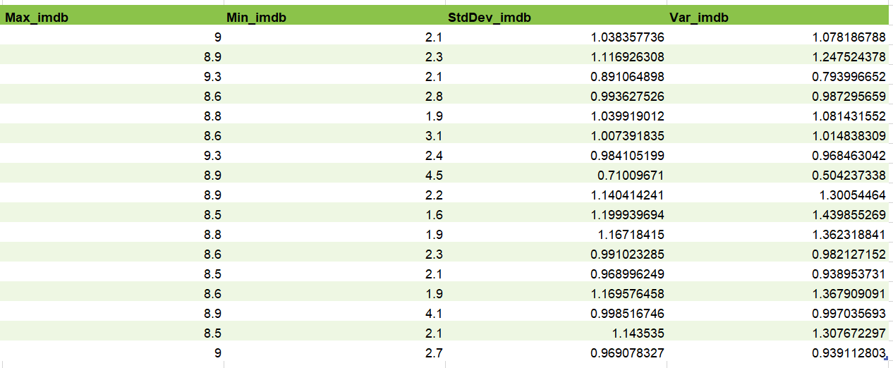
A: Movie Genre Analysis:

Slide 10
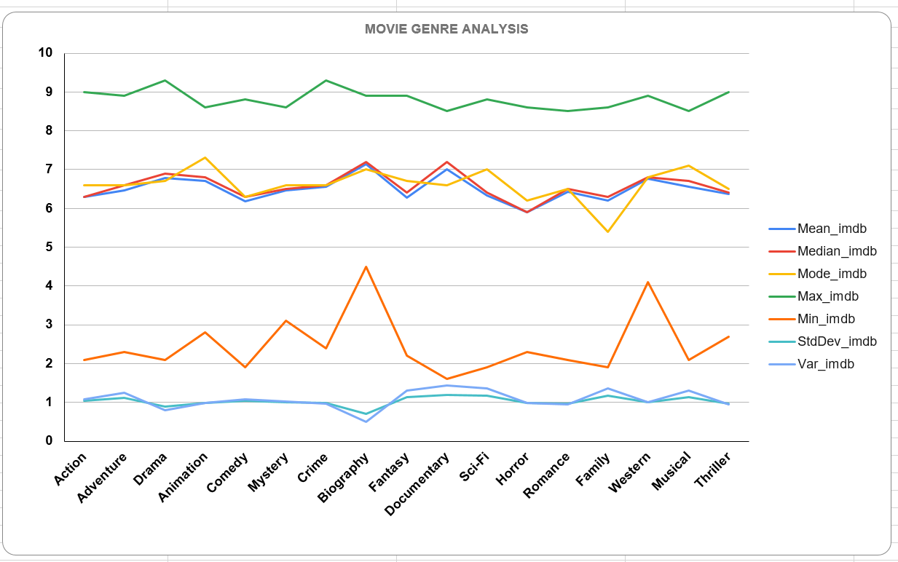
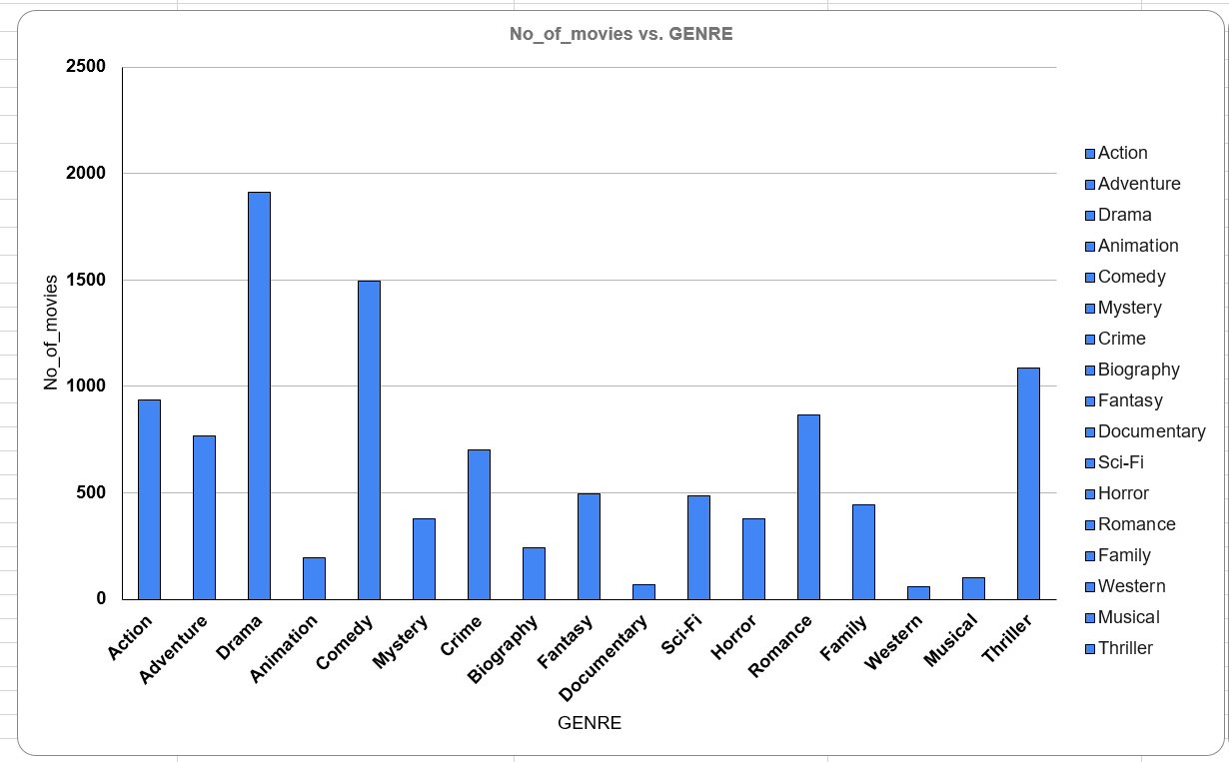
A: Movie Genre Analysis:
Result:

Slide 11
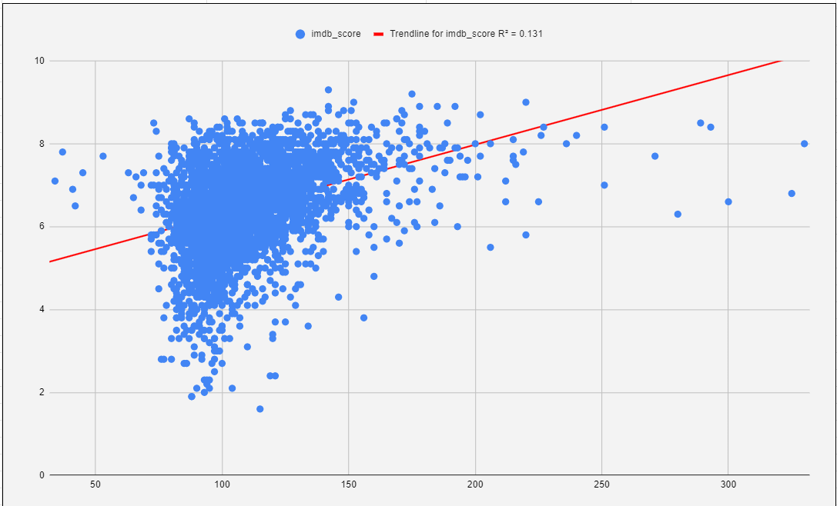
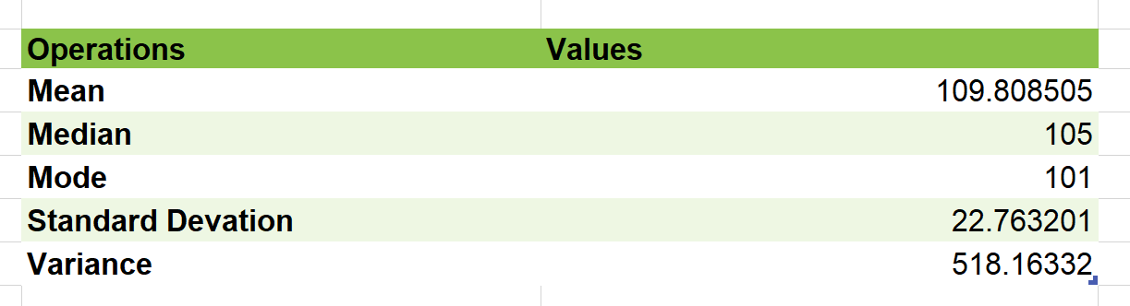
B: Movie Duration Analysis:
Analyze the distribution of movie durations and its impact on the IMDB score.
Task: Analyze the distribution of movie durations and identify the relationship
between movie duration and IMDB score.
Results:

Slide 12
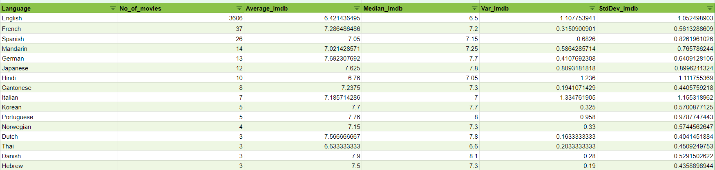
C: Movie Language Analysis:
Situation: Examine the distribution of movies based on their language.
Task: Determine the most common languages used in movies and analyze
their impact on the IMDB score using descriptive statistics.
Results:

Slide 13
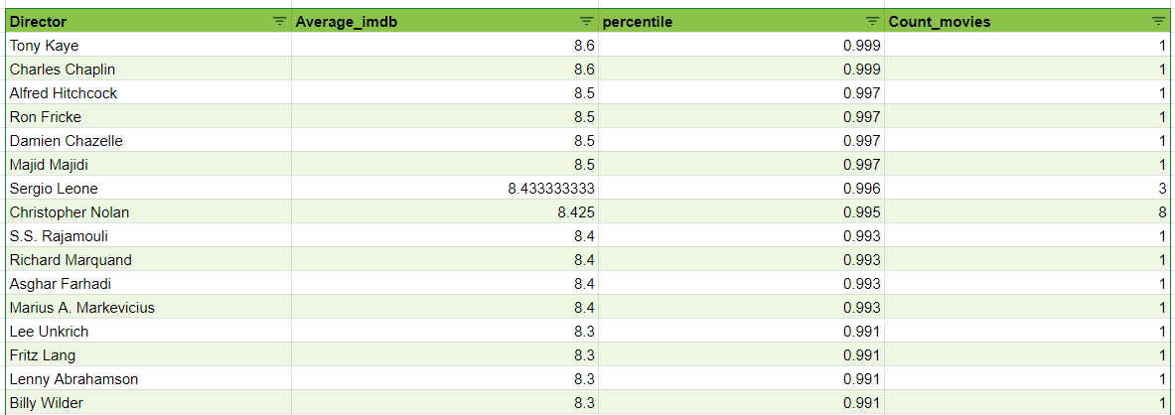
D: Movie Director Analysis:
Influence of directors on movie ratings.
Task: Identify the top directors based on their average IMDB score and analyze
their contribution to the success of movies using percentile calculations.
Result:

Slide 14
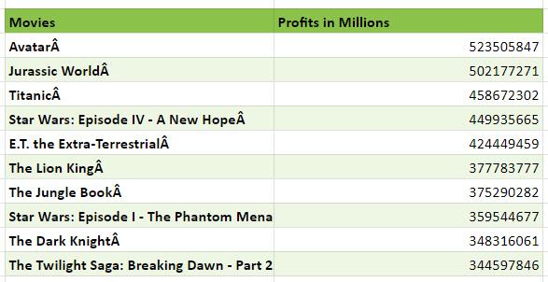
E: Movie Budget Analysis:
Explore the relationship between movie budgets and their financial success.
Task: Analyze the correlation between movie budgets and gross earnings, and
identify the movies with the highest profit margin.

Slide 15
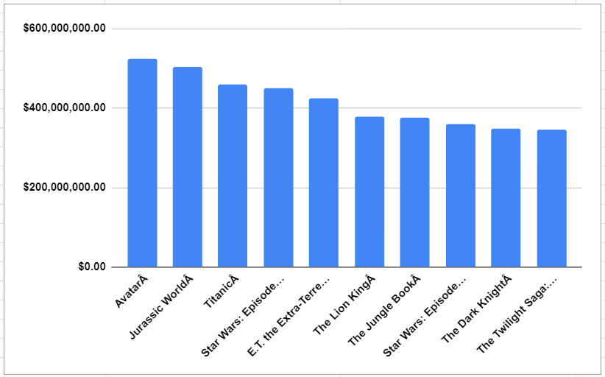
e: Movie Budget Analysis:

Slide 16
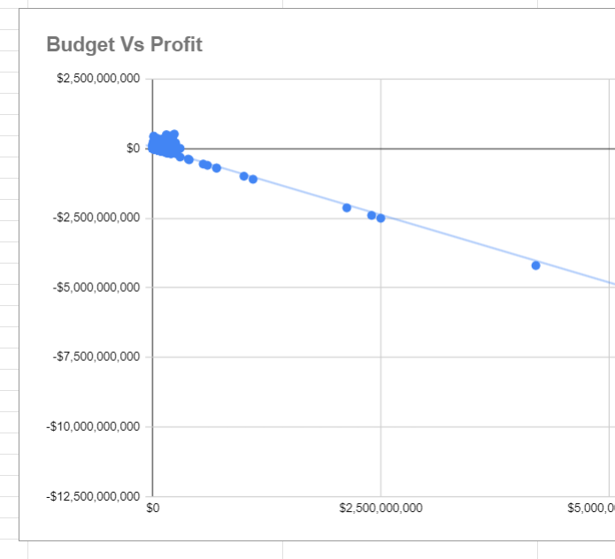
E: Movie Budget Analysis:
Correlation Graph:

Slide 17

The Most common movie genres from the dataset are Drama, Comedy, Thriller and Action.
The Average duration of a Movie is 109 minutes. The trendline between the duration vs imdb score is elevated upward with R^2 = 0.131
The Most common languages used in the movies are English, French, Spanish, Mandarin and German. I have also Observed that the languages Telugu and Persian have the highest average imdb score.
I have identified that Tony Kaye, Charles Chaplin, Alfred Hitchcock, Ron Fricke, Damien Chazelle, Majid Majidi, Sergio Leone, Christopher Nolan, SS Rajamouli and Richard Marquand are the top 10 directors with average imdb score >=8.4
The Top-5 with highest profits are Avatar, Jurassic World, Titanic, Star Wars: Episode IV - A New Hope and E.T. The Extra-Terrestrial. The Correlation between budget and gross is positive.

Slide 18

BY Afzal alam

